Slide 1
Working Virtual: Is Your Organization CyberSAFE?

Slide 2
PRESENTER
The global certification body of vendor neutral, emerging technology certifications and micro-credentials for Business, Data, Development, IT, and Security professionals
Jeff Felice
President
jfelice@certnexus.com

Slide 3
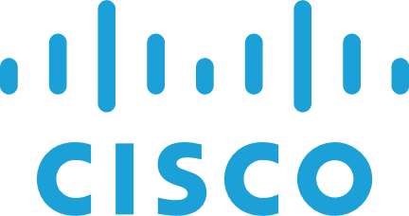
EXAM CANDIDATES ACROSS INDUSTRY

Slide 4
POLL
QUESTION: What is your role in cybersecurity? (Multiple Choice / Single Answer)
Answer 1: Cybersecurity Leader
Answer 2: Cybersecurity Technical Professional
Answer 3: IT Professional
Answer 4: Business Leader
Answer 5: End user or Student

Slide 5
$6.9 billion in reported losses to internet crimes in 2021, a $2.7 billion increase from 2020
- FBI's annual Internet Crime Report

Slide 6
What We’ll Learn Today
Why it is important for end-users to identify the need for security, secure their devices and data, and learn to safely navigate their ever more connected world
How organizations that implement cyber awareness compliance programs can reduce incidents by up to 70%

Slide 7
POLL
QUESTION: How often to cyber attacks occur globally? (Multiple Choice / Single Answer)
Answer 1: One every week
Answer 2: One roughly every day
Answer 3: One approximately every hour
Answer 4: One less than every minute
Notes:
QUESTION: How often to cyber attacks occur globally? (Multiple Choice / Single Answer)
Answer 1: One every week
Answer 2: One roughly every day
Answer 3: One approximately every hour
Answer 4: One less than every minute
CORRECT ANSWER(S): 4

Slide 8
‘EVERY 39 SECONDS THERE IS A CYBER ATTACK’
- University of Maryland Study

Slide 9
Notes:
Many companies have moved virtual overnight without the opportunity to safely prepare end-users for remote work.
Over time, IT and Security teams have reconfigured systems and related policies to better protect your infrastructure and data but may struggle with less oversight over end-user environments.
With ransomware attacks on the rise and phishing a continued threat to businesses of all sizes what is the basic awareness you need at this time?
We will explore this question and more over the next 30 minutes as we all work to better prepare our organizations against cyber incidents.

Slide 10
IT’S ALL TOO HUMAN
85% of breaches result of human element, 36% involved phishing, and 10% included ransomware
43% of all data breaches involve small and medium businesses
- Verizon 2021 Data Breach Investigation Report
Notes:
A single email can lead to a multi-million-dollar breach in seconds, and the employee responsible may not even be aware of their mistake. The problem is that many end users are not aware of the dangers accompanying today’s most common cybersecurity threats, much less how to detect them.

Slide 11
The End User Challenge
- Proofpoint 2020 User Risk Report

Slide 12
The State of End User Cyber Safety - Phishing
Google has registered over 2 million phishing sites
11% of users clicked on a simulated phishing email. That increased to 20% of phishing tests with attachments
- Proofpoint: State of the Phish 2021

Slide 13
The State of End User Cyber Safety - Ransomware
Fewer organizations suffered data encryption as the result of a significant attack – down from 73% in 2020 to 54% in 2021
Financial impact of a ransomware attack has more than doubled, increasing from US$761,106 in 2020 to US$1.85 million in 2021
Average amount of data recovered after paying a ransom is 65% with only 8% of companies recovering all data
- Sophos Global State of Ransomware (2021)

Slide 14
POLL
QUESTION: Who in your organization is responsible for cybersecurity? (Multiple Choice / Single Answer)
Answer 1: Security team
Answer 2: IT team
Answer 3: C-suite
Answer 4: Employees
Answer 5: All the above
Notes:
QUESTION: Who in your organization is responsible for cybersecurity? (Multiple Choice / Single Answer)
Answer 1: Security team
Answer 2: IT team
Answer 3: C-suite
Answer 4: Employees
Answer 5: All the above
CORRECT ANSWER(S): All the above

Slide 15
How we think of Cybersecurity

Slide 16
How we should think of Cybersecurity!

Slide 17
Who is responsible for Cybersecurity?

Slide 18
Cybersecurity & CyberSafety
End User

Slide 19
POLL
QUESTION: What is the average cost impact for a data breach or ransomware? (Multiple Choice / Single Answer)
Answer 1: Less than $10,000
Answer 2: Between $10,000 and $100,000
Answer 3: Between $100,000 and $1,000,000
Answer 4: More than $1,000,000
Notes:
QUESTION: What is the average cost impact for a data breach or ransomware? (Multiple Choice / Single Answer)
Answer 1: Less than $10,000
Answer 2: More than $1,000,000
Answer 3: Between $10,000 and $100,000
Answer 4: Between $100,000 and $1,000,000
CORRECT ANSWER(S): 2

Slide 20
Poor End User Preparation Comes at a Cost
Financial impact of a ransomware attack has more than doubled, increasing from US$761,106 in 2020 to US$1.85 million in 2021
- Sophos Global State of Ransomware (2021)
The impact of a data breach on an organization averages $4.24 million with each record averaging a cost of $161
- IBM 2021 Cost of a Data Breach

Slide 21
WE MUST BE PREPARED!
Product
Hardware and Software
Process
Laws, regulations, policies, compliance, and governance
People
Provide annual compliance training for all employees, contractors, and users
Practice cyber safety through phishing simulations and other practice drills
And most importantly create a culture of CYBER SAFETY

Slide 22
Cyber Awareness Compliance
Test knowledge to establish baseline
Compliance training for ALL employees and contractors
Retest knowledge
Remediate as necessary
Repeat Steps 2-4 annually
Don’t Ever Stop!

Slide 23
And When in Question
DO THE FOLLOWING:
STOP – cease what you are doing immediately
Think – question the conditions of the situation
Act – either proceed as normal or inform the appropriate persons

Slide 24
The Benefits
Company-wide cyber awareness training program can reduce incidents by up to 70%
Organizations who have implemented company-wide cyber awareness programs can submit to reduce cybersecurity insurance premiums

Slide 25
WHO REQUIRES CYBER AWARENESS TRAINING?
Cyber Insurance Companies
International Regulations
National/State Laws
Industry Regulations
Company Policy

Slide 26
CyberSAFE
Description
Enables your employees to identify the most common risks involved in using conventional, mobile, and cloud technologies, as well as how to protect themselves and your organization from cyber threats
Target Audience
This credential is designed for all end-users of computers, mobile devices, networks, and the Internet to ensure they can use technology safely to minimize security risks.
Knowledge Assessed
Compliance = 16%
Social Engineering = 32%
Device and Data Protection = 24%
Online Security = 28%
Notes:
CyberSAFE™ enables your employees to identify the most common risks involved in using conventional, mobile, and cloud technologies, as well as how to protect themselves and your organization from cyber threats.

Slide 27
POLL
QUESTION: What is not a digital form of social engineering? (Multiple Choice / Single Answer)
Answer 1: Phishing
Answer 2: Smishing
Answer 3: Tailgaiting
Answer 4: Vishing
Notes:
QUESTION: What is not a digital form of social engineering? (Multiple Choice / Single Answer)
Answer 1: Phishing
Answer 2: Smishing
Answer 3: Tailgaiting
Answer 4: Vishing
CORRECT ANSWER(S): 3

Slide 28
Q&A
THINK. BUILD. SECURE.

Slide 29
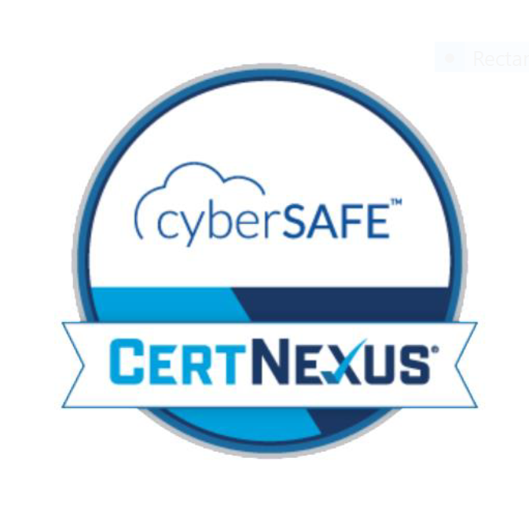
Readiness Assessment
Check your cyber knowledge
Measure your level of preparedness against cyber threats with our complimentary CyberSAFE Readiness Assessment. This tool was designed to measure knowledge of hot to detect and avoid imminent cyber threats.
Redeem your free access key (##########) at https://lochoice.com.

Slide 30
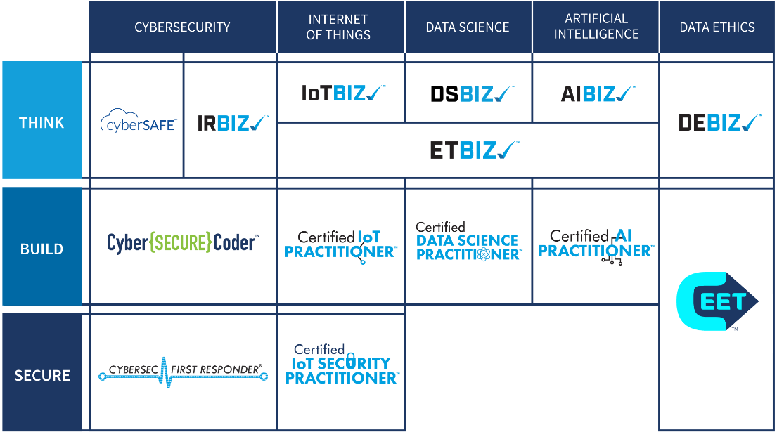
CERTNEXUS SKILLS ROADMAP
Narrowing the widening skills gap within emerging technology

Slide 31
CERTNEXUS PATHWAYS BY ROLE

